Slide 1
Year 11 Lessons 4 & 5 AFL: Task 3
Learning Objective:
To revise our English skills in applying linguistic and literary concepts and skills in a variety of authentic contexts.
Lesson Outcomes:
1.) To revise the key features and devices of non-fiction text-types.
2.) To connect learning from other MYP subjects on topic of Globalisation and Sustainability with our English Task 3 (Production of Non-fiction Text)
3.) To incorporate genre conventions in an effective manner.

Slide 2
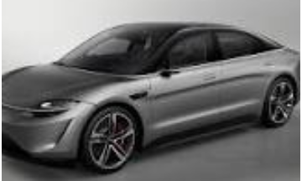
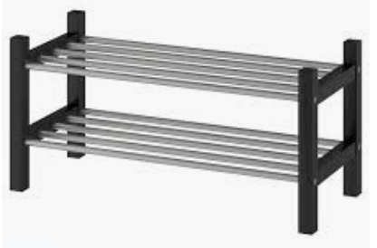
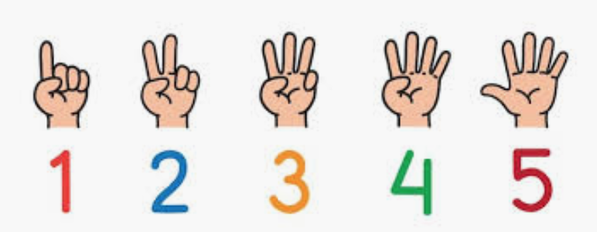
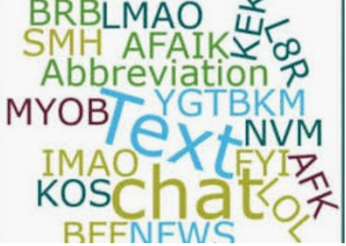
Starter: Can you identify the English Key or Related Concepts from these pictorial ”Dingbats”?!
1.)
minus the ‘S’!
2.)
minus the ‘N’!
3.)
minus the ‘U’
Now, write down all the other Key and Related Concepts for English Lang./Lit.

Slide 3
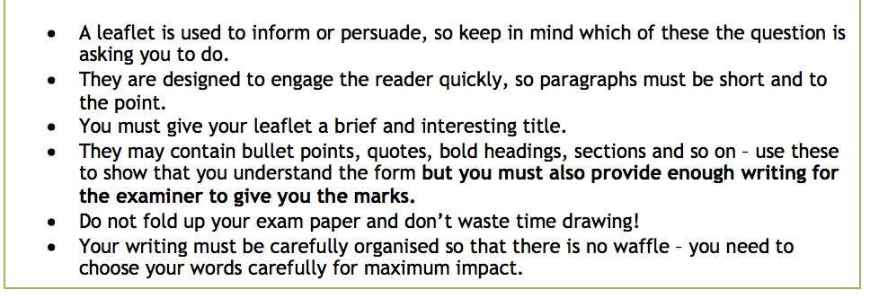
Activity 1: Revising non-fiction text types
Read these lists of features and stylistic devices for 4 different texts and identify which text type you think they match.

Slide 4
Some information and reminders…
For Task 3, the focus is on your knowledge and learning of Non-Fiction texts conventions.
You will be assessed for:
B → Organisation,
C → Production of Text, (imagination, creativity)
D →Language features associated with the text type
E → Integration of Global Context
Set yourself targets for each of these 4 Objective areas (based on feedback received from peers and teacher). This will be your focus for the Task 3.

Slide 5
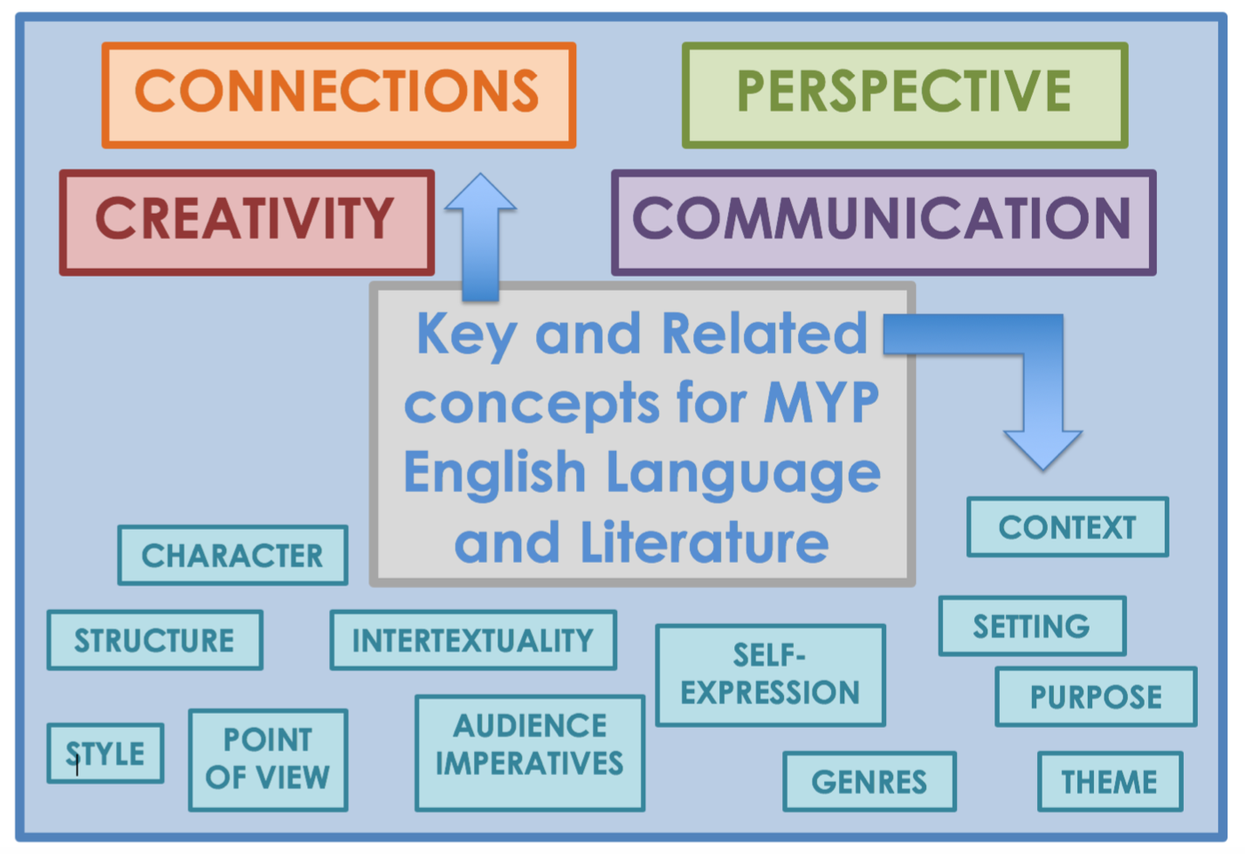
2nd Activity : Now go back to our discussion about the UN sustainable goals and our Key/Related English Concepts.
*How is everything connected?
*What is the relationship between personal, local and global processes?
*What is the impact of decision-making on humankind and the environment?
*How do language and literary skills help us to engage with these global issues?
Class Discussion Opportunity – share thoughts on these guiding questions

Slide 6
Here is an example of a past Task 3 Question:

Slide 7
3rd Activity: Writing Practice – Choose one of the following text-types
Letter
‘Junk food is too appealing, too affordable and too easily available to children. Every shop should do more to promote healthy eating.’
Write a letter to the manager of a local supermarket expressing your views on this statement.
Speech
‘Competitive sports are vital for this generation of young people. They help develop resilience, confidence and self-esteem’.
Write a speech to be given to the senior management team at your school explaining your views on this statement.
Article
‘Politicians have lost all credibility with today’s young people. They need a completely new approach to engage us in politics’.
Write an article for a magazine aimed at teenagers in which you give your opinion on this topic.
Leaflet
‘The responsibility for environmental damage lies with all of us; every individual can do their bit to reverse the destruction of our planet.’
Write the text for a leaflet persuading local residents to get involved in environmental issues in your neighbourhood.

Slide 8
3rd Activity: Writing Practice Planning
Select the text type you want to write on
Use bullet points/mindmap 3-4 points that you will write to address the prompt
Make a list of the genre conventions associated with your selected text type
Plan how you will use the genre conventions (you may link each genre convention to each bullet point)
Plan 3-4 ways you can integrate Global Context in your response/bullet points
Write your Task 3
Use the Task 3 Peer Checklist to give feedback

Slide 9
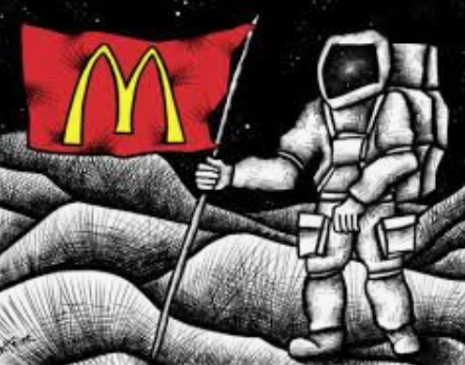
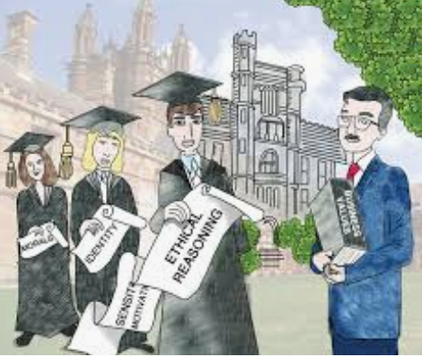
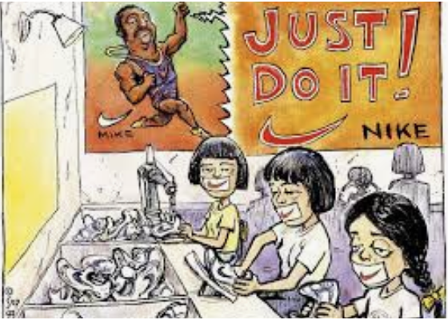
Creative Concluding Plenary:
Create a Concept Cartoon [or Pictorial Dingbat (like our Starter!)] for presenting key words, related and key concepts for English, Global Contexts OR simply your approach to the Topic Area of Globalisation and Sustainability.
What is a Concept Cartoon?
Concept cartoons are a visual representation of science ideas. The simple cartoon style drawings put forward a range of viewpoints about science ideas in situations that are designed to motivate and engage students and stimulate discussion of their ideas.

Slide 10
Answers:
Starter Pictorial Dingbats =
1.) Perspective
2.) Character
3.) Context
Task 2: Text types
1.) Speech
2.) Opinion Column or article
3.) Leaflet. -information text
4.) Essay – discursive writing

